Slide 1

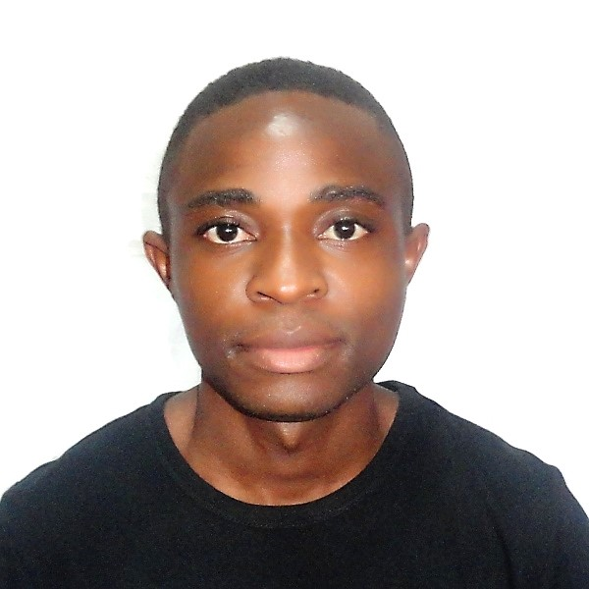

Project 9:
Survey the technology landscape
Web sites and links to search on technologies
Feedly Dashboard
Feedly Dashboard
Follow Me on Twitter and LinkedIn
Alexandre Massoda
currently following
the Front-End Developer path
at OpenClassrooms.
Welcome
List of technologies

Slide 2
Project 9:
Survey the technology landscape
I’m interested in :
HTML,
CSS,
Bootstrap
MySQL
JavaScript
React
Flutter
Python (Django Framework)
PhP
Ruby and Ruby on Rails
Web sites and links to search on technologies
Feedly Dashboard
Follow Me on Twitter and LinkedIn
Alexandre Massoda
currently following
the Front-End Developer path
at OpenClassrooms.
List of technologies
Welcome

Slide 3
https://openclassrooms.com
https://github.com
https://stackoverflow.com
https://freecodecamp.org
https://scrimba.com
https://khanacademy.org
YouTube Channels:
freeCodeCamp
Scrimba
Fromscratch
Khan Academy
JavaScript de Zéro
Benjamin Code
Project 9:
Survey the technology landscape
Web sites and links to search on technologies
Feedly Dashboard
Follow Me on Twitter and LinkedIn
Alexandre Massoda
currently following
the Front-End Developer path
at OpenClassrooms.
List of technologies
Welcome

Slide 4
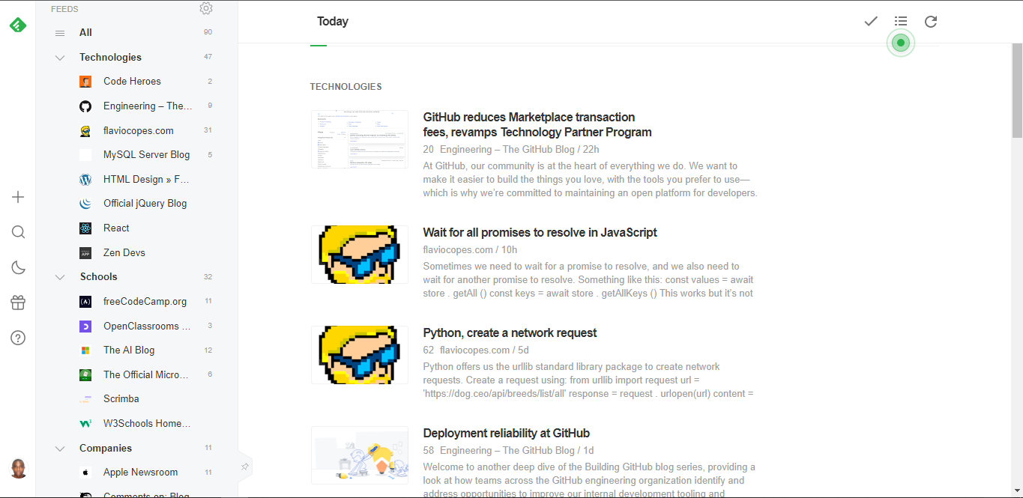
Project 9:
Survey the technology landscape
On Feedly i’ll also have the news on my focused technologies (HTML5, CSS3, JavaScript, React, ) ; on the subjects throw OpenClassrooms (and the others schools Scrimba, FreeCode Camp, Khan Academy …) and finally on differents Tech Companies.
Web sites and links to search on technologies
Feedly Dashboard
Alexandre Massoda
currently following
the Front-End Developer path
at OpenClassrooms.
Follow Me on Twitter and LinkedIn
List of technologies
Welcome

Slide 5
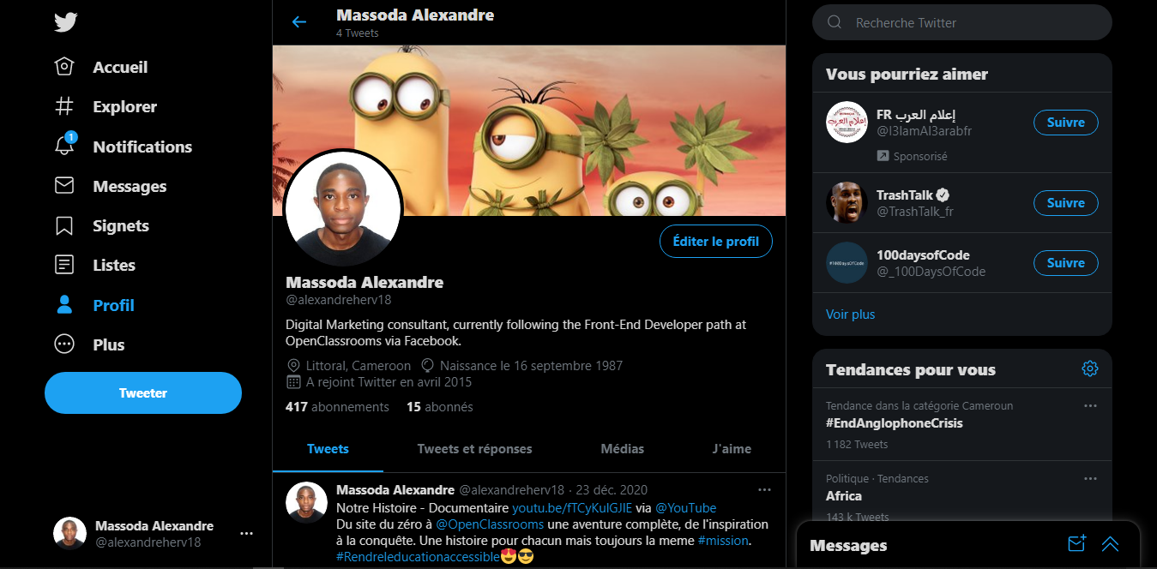
Twitter’s Link:
Massoda Alexandre (@alexandreherv18) / Twitter
Project 9:
Survey the technology landscape
Web sites and links to search on technologies
Feedly Dashboard
Follow Me on Twitter and LinkedIn
Alexandre Massoda
currently following
the Front-End Developer path
at OpenClassrooms.
Welcome
List of technologies
On Twitter with my twitter personal account i can follow and get news from many schools (OpenClassrooms, Scrimba, Free Code Camp), Web Developers (Like Bob Ziroll of Scrimba, Quincy Larson of freeCodeCamp, Wes Bos …)
You can also find me on LinkedIn:
www.linkedin.com/in/alexandre-massoda
And get me on GitHub To:
https://github.com/Xander1936
Thank You For Watching.
☺☺☺

